Slide 1
SOFE 3650 – Software Design and Architectures
A Course in the study of the Design of Software Architectures and Design Patterns.
The 2nd course of the Software Design Courses
SOFE 2720 – SOFTWARE REQ. SPEC.& ANALYSIS
SOFE 3650 – SOFTWARE DESIGN and ARCHITECTURES

Slide 2
The Study of Software Architectures
How are Software Systems Designed and built?
The goal is to design a software system that addresses the quality attributes of the requirements (i.e. typically the non-functional requirements)

Slide 3
Software Architecture References
There are many “different” types of references available.
Not one book appears to be suitable because the concept is rather abstract and well defined.
Course textbooks
Software Architecture: Foundations, Theory, and Practice; Taylor, Medvidovic, Dashofy:
This is a more foundational book but lacks concrete examples
Designing Software Architectures: A Practical Approach Humberto Cervantes, Rick Kazman:
This book presents a design approach that we will practice and several case examples.
Other Books
Software Architecture in Practice, 3/e Bass, Clements & Kazman:
Used last year and relates software architecture to quality attributes but does not relate the quality attributes well to the architectures.

Slide 4
Architecture Analogies
Building Architectures

Slide 5
Is Software Architecture like Building Architecture?
A building’s architecture, that is, its major elements, their composition, and arrangement, can be described, discussed, and compared with those of other buildings.
This can also be done with software architecture by comparing one design to another.
Properties of structures are induced by the design of their architecture
properties of software applications, such as resilience in the face of particular types of security attacks, are determined by the design of their architectures.
Recognition of the distinctive role and character of an architect, the person responsible for the creation of the architecture
Wow this is interesting. A simple skill in programming is not sufficient for the creation of complex software applications that people can effectively employ.
Process is as important as architecture. Simply following a process does not guarantee that a successful building will emerge.

Slide 6
Where it Differs
We know a lot about buildings from years of experience but this Is not the case with software.
The medium for software is code and it is difficult to discern the architecture from the code.
It is also more difficult to measure and analyze. In fact to find a good reference on architecture analysis is a challenge.
Software can manage change but physical buildings cannot.

Slide 7
Software Architecture in the Context of the Software Cycle

Slide 8
Three Fundamental Points
Every application has an architecture.
because they all result from key design decisions.
Every application has at least one architect.
makes the principal decisions about the application
Architecture is not a phase of development.
refers to the conceptual essence of an application, the principal decisions regarding its design, the key abstractions that characterize the application.

Slide 9
The Fundamental Steps in Software Engineering
Architectural design is a vital part of the Modeling (in particular analysis) step in the Software Engineering life cycle no matter what process is used.
Waterfall
Iterative
Agile
Model-driven development
DevOps

Slide 10
The Analysis Model

Slide 11
Architecture in Practice
Architectural design primarily occurs in the Design stage of the software but it does permeate into the requirements and implementation stage as well because:
Existing designs and architectures provide the vocabulary for talking about what might be.
Our understanding of what works now, and how it works, affects our wants and perceived needs,
The insights from our experiences with existing systems helps us imagine what might work and enables us to assess, at an early stage, how long we must be willing to wait for it, and how much we will need to pay for it.

Slide 12
Architecture and the Software Process
Let’s go back and re-visit the question about where the architecture fits in the software process.
Architecture, correspondingly, is not a phase in a software engineering process; it is a core, evolving body of information.
Because of this software architecture does not appear prominently in most software processes models, but exists as an artifact of the software development process.
Taylor et al. (textbook) presents a unique software centric process approach that he calls “turbine visualization” that we will not cover in detail in the course but it is worth viewing the process as a collection of activities and artifacts.

Slide 13
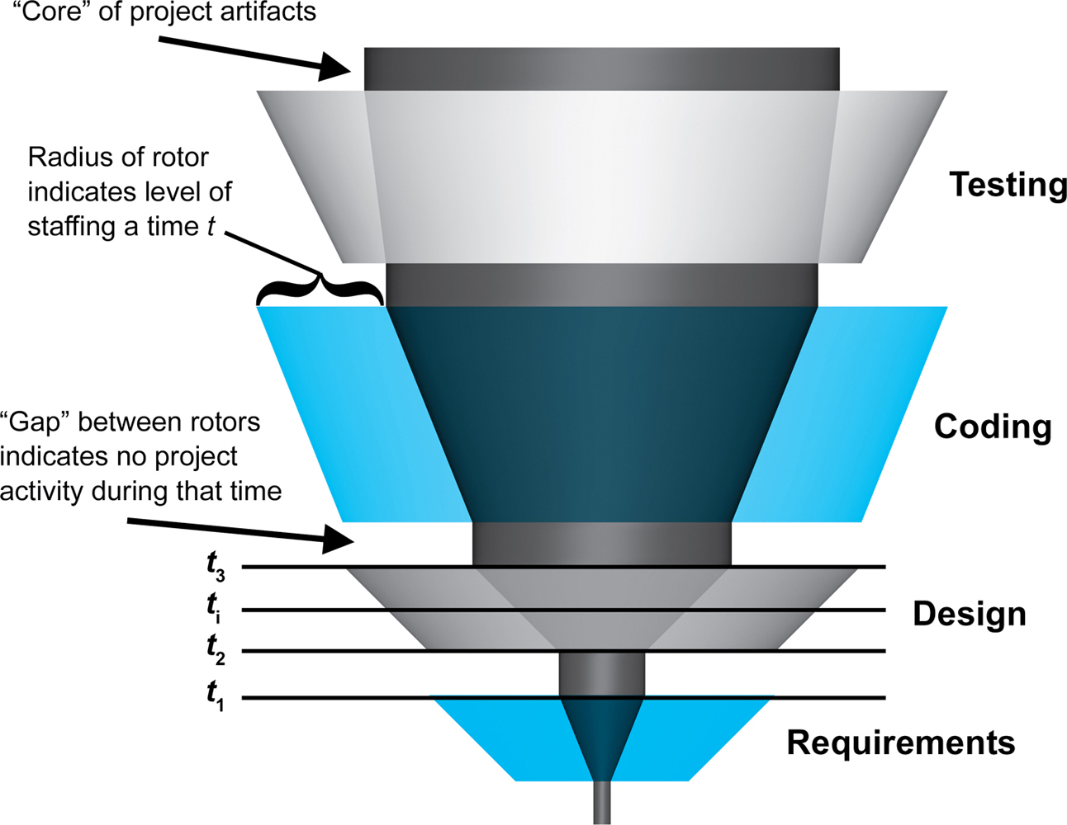
The Turbine Visualization Process of a Waterfall Process

Slide 14
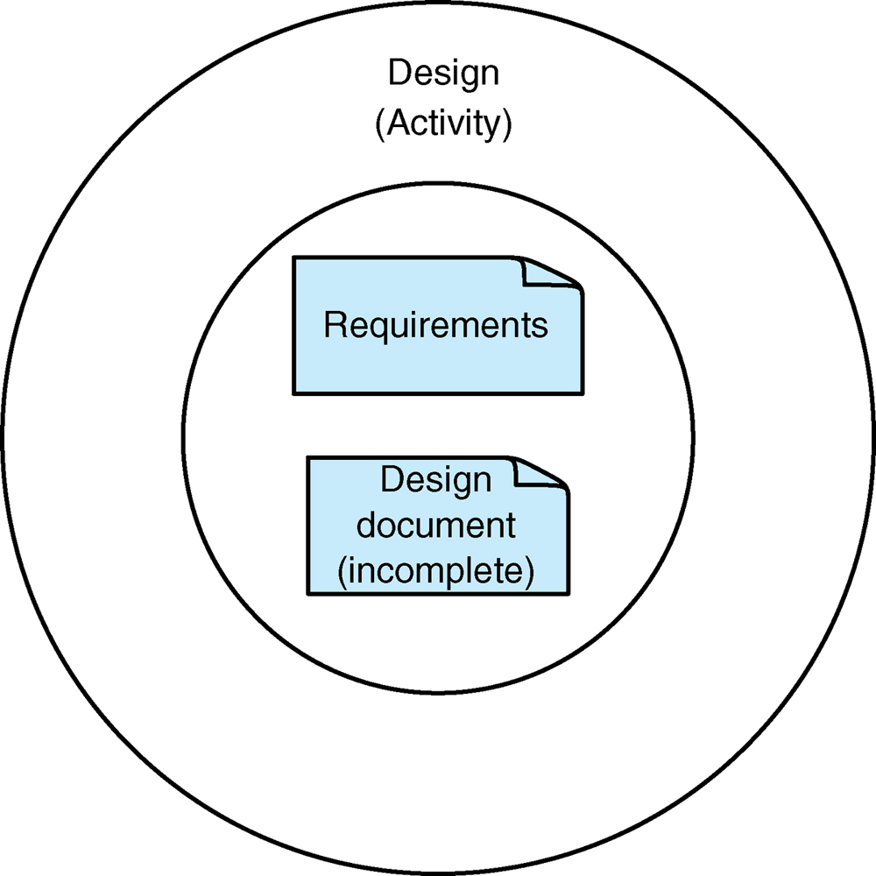
A Cross Section at the Design Stage
This is the Activity
These are the Artifacts at this Stage and Time Slice

Slide 15
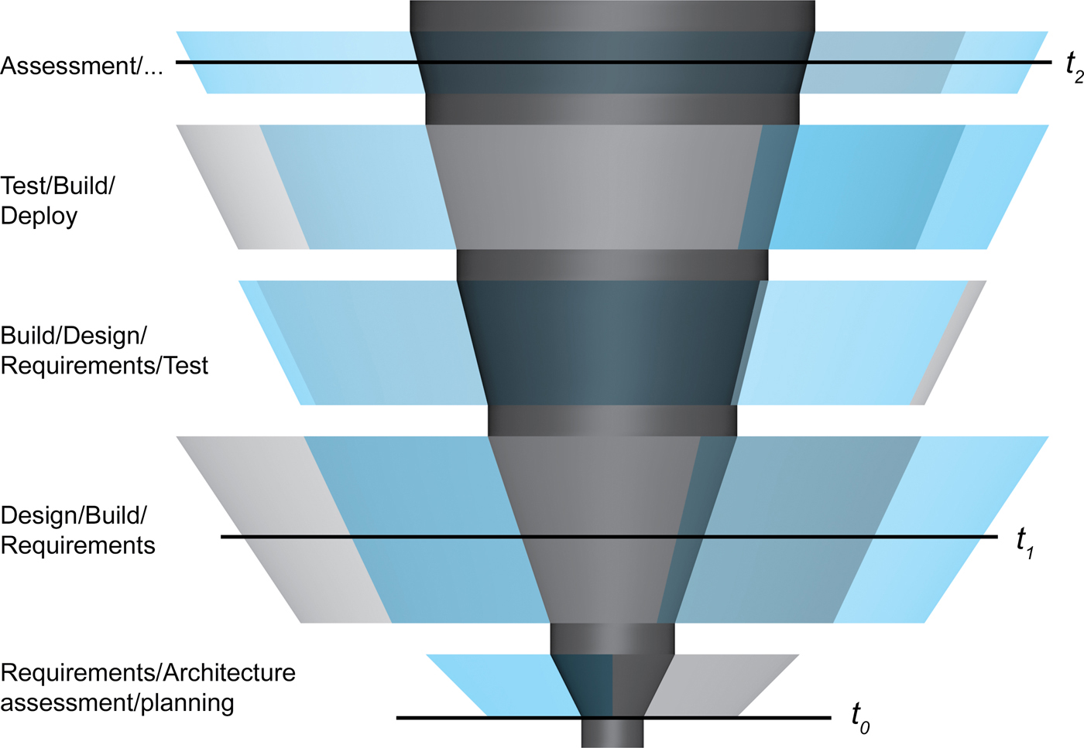
A More Realistic Process where Activities Occur in Parallel

Slide 16
What do you think this Slice looks like at the Start of a Project?

Slide 17
What would it look like at the Design/Build/Requirements stage

Slide 18
Architecture and the Agile Software Process
Agile processes are positive in showing, and emphasizing, concurrency between a variety of kinds of development activities; requirements elicitation and development of tests, for instance.
however, the agile process denies development of any explicit architecture; rather for the agile developer the code is the architecture.
The problem with this is the creation of the next version or modification of the product.
Up to 50% of the effort for phase 2 will be used to recover the software architecture of the product.

Slide 19
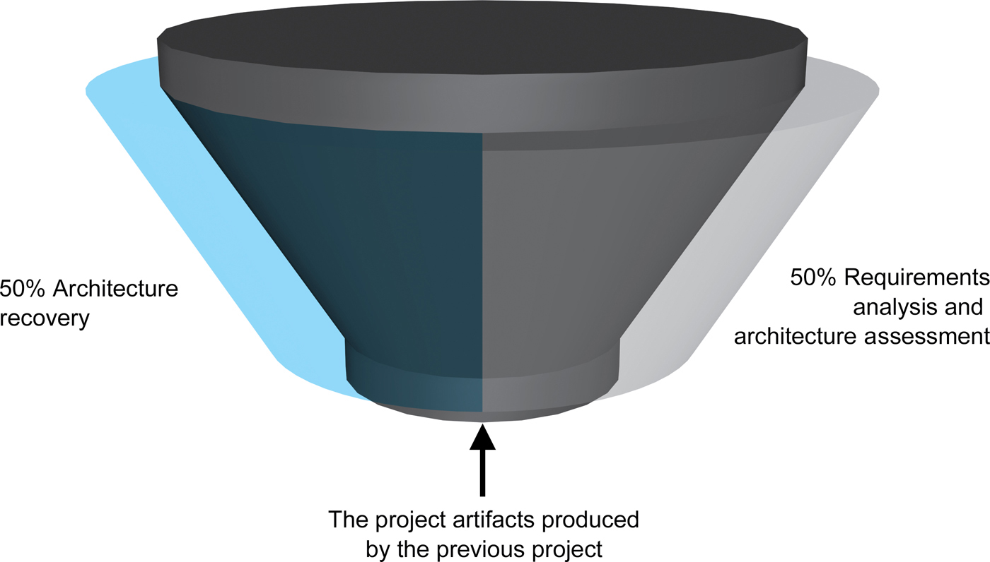
The Result of the Agile Process on a New Version of the Software Product

Slide 20
Architecture in Support of Analysis
The earlier an error is detected and corrected, the lower the aggregate cost
the structural architecture of an application can be examined for consistency, correctness, and exhibition of desired nonfunctional properties.
the architectural model can be examined for internal consistency and correctness:
Mismatched components, missing information, etc.
consistency with requirements.
architectural model may be used in determining and supporting analysis and testing strategies applied to the source code.

Slide 21
Architecture in Support of Evolution and Maintenance
In best practices approach each type of change causes the software process to return to whatever phase that issue is usually considered in.
Software evolution also has the same effect.
Unfortunately, it is common for only the coding phase to be revisited.
Where architectural consistency with the implementation is vital is in the analysis of new versions of a software product.
This analysis can be done at the architectural abstraction if available, if not then the code has to be reversed engineered.
Very costly operation.

Slide 22
Architecture at the Implementation Stage
Ideally the objective would be to keep the architecture developed in the design stage through the implementation stage. How can this be achieved?
Through automatic code generation (generative technologies)
Through the use of frameworks.
the framework provides the bridge between concepts from the architecture and concepts from the platform (that is, programming language and operating system).

Slide 23
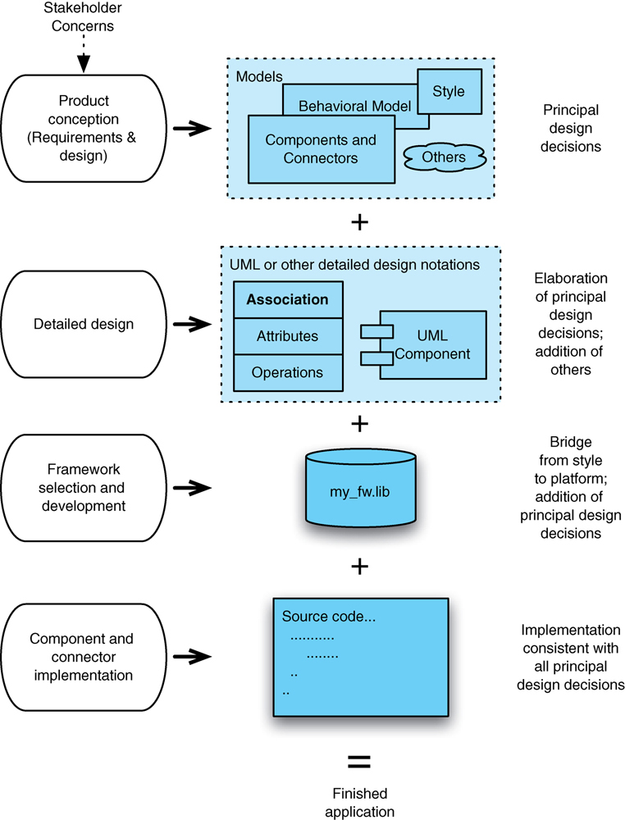
A Typical Set of Steps in a Software Product leveraging a Framework
The adoption of a framework will influence the architectural choices.
Use of MFC, Swing, etc.
Middleware platforms also influence the architecture.
CORBA, RMI, DCOM, etc.

